Slide 1

Lesson 11: Optimizing for Alternative Search Engines
Kubilay Cagatay
WEB 225

Slide 2

Are Google and Bing the only ones?
NO! Although they are by far they are the largest and dominate the market in most countries
SEO strategies are usually directed to optimize page rank on them however you can and should also optimize for alternative search engines well

Slide 3

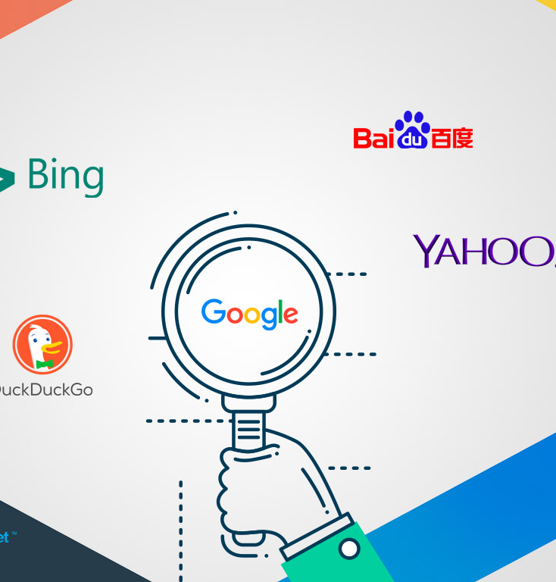
What are some other big ones?
Some other alternative search engines include:
Amazon
YouTube
Facebook
Delicious
Flickr
Twitter

Slide 4

Amazon
World’s largest online retailer
Highly optimized and has a huge customer base
How do products get ranked? By product name relevancy metrics and through the use of tags
Great tool for selling products and SEOs should explore it especially if your search engine page rank is not high

Slide 5

YouTube
Most popular video website on the internet
Helpful for video content producers
How do products get ranked? By video title, description and engagement as well as inbound links to the video
Since video thumbnails show up in Google search results, videos have a higher interaction level than just traditional text. Videos can receive an incredible amount of views in mere days!

Slide 6


Facebook
The most popular social network in the world (at the time of the book)
Facebook search results include people, businesses, groups, interests, locations, and items.
Effective way to have content interaction: community engagement and ”shares”
When users search with Bing, their results can be personalized based on Facebook considerations

Slide 7
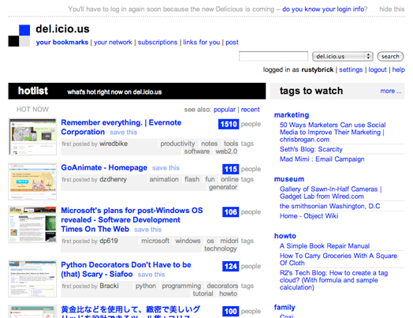
Delicious
A repository for articles that users wish to save – a huge change to how people organize information online and see what others are saving
Tremendous traffic generating tools
How do products get ranked? By the number of bookmarks in the last 3600 seconds, number of bookmarks overall and general site authority
Strives to keep all content away from search engines

Slide 8
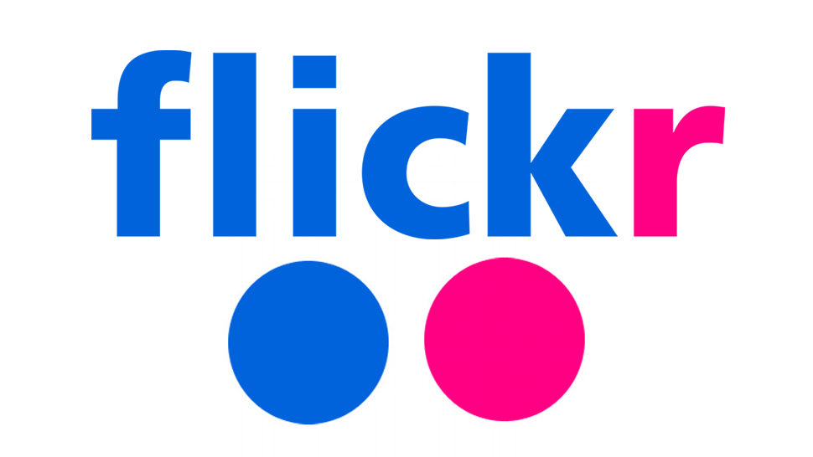
Flickr
World’s first mainstream online social photo site
Great for photo search
How do products get ranked? Photo title, tags and description
Optimizing the image for Flick is easier than optimizing the image on a given website and can provide a lot of value without doing traditional image SEO

Slide 9

Twitter
Micro blogging platform
Users can “pass around” links to content
How do products get ranked? Based on relevancy and time
Twitter results have a major effect on the primary search engine result pages
Tweets even show up as news on Google's main page!

Slide 10
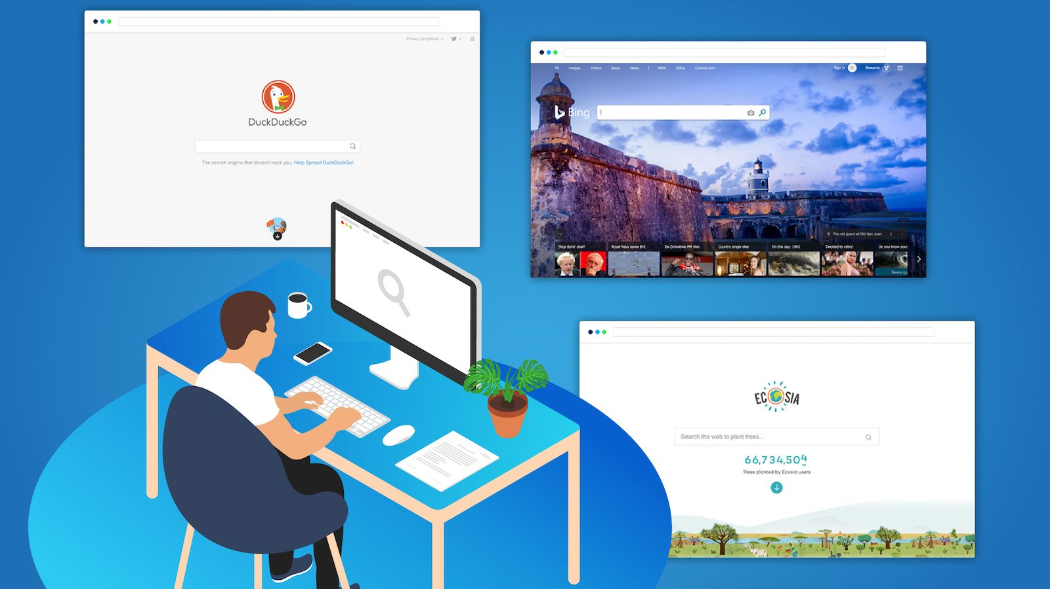
Alternative Search Engines
Optimizing for all the different alternatives may be difficult but it is well worth it

Slide 11

Thank you!

